Slide 1

Extended Relational Algebra
Database Management System | Relational Model and Formal Query Languages
Course: Database Management System | Chapter: Relational Model and Formal Query Languages | Program: Bachelor of Engineering
DISCOVER · LEARN · EMPOWER
Notes:
Welcome everyone to today's lecture on Extended Relational Algebra. This topic builds directly upon the basic operators we learned earlier. We will explore how to make our queries more powerful and expressive. Remember, mastering this is key to writing efficient database queries.

Slide 2
Course Outcomes
SLIDE 2 / 14
Course Outcome
CO | BT LEVEL | DESCRIPTION
CO1 | BT2 | Explain database architecture, relational model concepts and formal query language foundations including relational algebra and relational calculus.
CO2 | BT3 | Apply relational algebra, relational calculus and SQL constructs to formulate correct and efficient database queries.
CO3 | BT4 | Analyze functional dependencies and design normalized relational schemas up to 5NF ensuring lossless join and dependency preservation.
CO4 | BT4 | Analyze transaction schedules and concurrency control mechanisms to determine serializability, recoverability and correctness.
CO5 | BT5 | Evaluate storage structures, indexing strategies and query optimization techniques for performance, scalability and reliability.
Chandigarh University
2 / 14
Notes:
Today's lecture directly supports our Course Outcomes. CO3 focuses on schema design and normalization, which relies on understanding relational operations. CO4 deals with transaction schedules, where extended algebra helps define complex query behaviors. These outcomes ensure you can design robust and correct database systems.

Slide 3
Learning Objectives
SLIDE 3 / 14
Learning Outcomes
1
Define the purpose of extended relational algebra operators in query processing.
2
Analyze how division and assignment operators extend basic relational capabilities.
3
Evaluate the role of aggregation functions in summarizing large datasets.
4
Apply generalized projection to select and rename attributes dynamically.
5
Demonstrate the use of outer joins to handle missing data gracefully.
Chandigarh University
3 / 14
Notes:
By the end of this session, you will be able to define why we need extended operators. We will analyze specific operators like division and assignment that are not in the basic set. You will also evaluate how aggregation functions help summarize data. Finally, you will apply these concepts to real-world query scenarios.

Slide 4
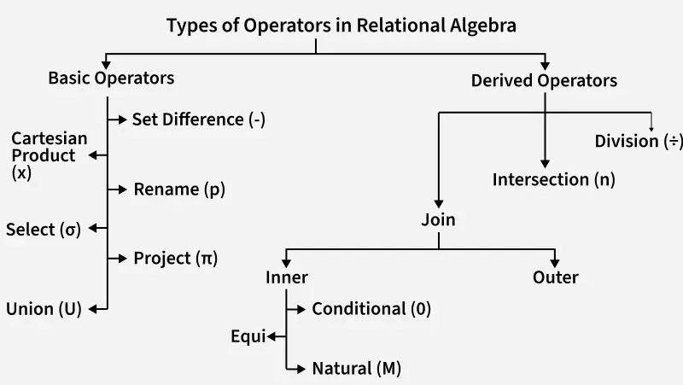
Lecture
SLIDE 4 / 14
Need for Extended Operators
1
Basic algebra cannot express all queries required in practical applications.
2
Division operator is essential for queries involving 'for all' conditions.
3
Assignment operator allows naming intermediate results for complex queries.
4
Aggregation functions enable summarization like sum, count, and average.
5
Outer joins preserve tuples from one relation even without matches.
6
Generalized projection supports arithmetic expressions and renaming in output.
Introduction to Relational Algebra in DBMS - GeeksforGeeks
Chandigarh University
4 / 14
Notes:
Basic relational algebra is powerful but limited. For instance, finding students who have taken ALL courses requires the division operator. Without assignment, complex queries become unreadable chains of operations. Aggregation is crucial for business intelligence, like calculating total sales per region.

Slide 5
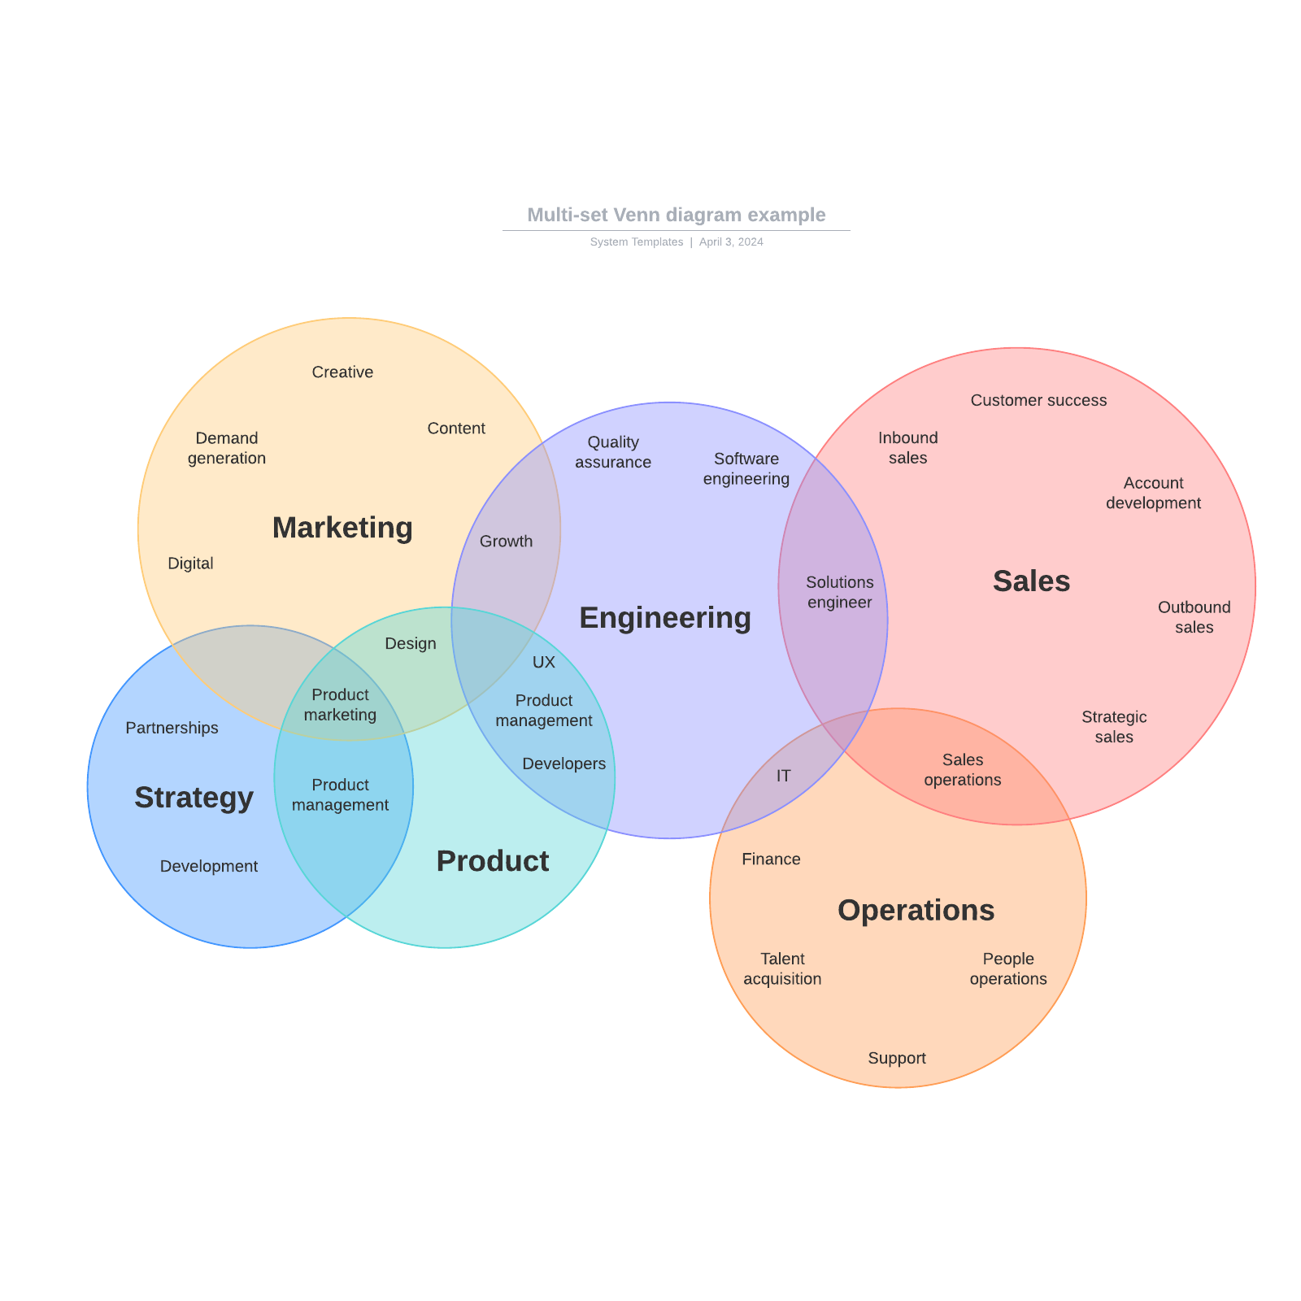
Lecture
SLIDE 5 / 14
Relational Division Operator
EXAMPLE
Find students who have enrolled in every course offered.
• Division R ÷ S returns tuples from R that match every tuple in S.
• It is used to answer queries containing the phrase 'for all' or 'every'.
• The result contains attributes from R that are not in S.
• Mathematically, it finds tuples t such that for all s in S, (t, s) exists in R.
• This operator is computationally expensive and often optimized by the DBMS.
Source: corporate-assets.lucid.co
Chandigarh University
5 / 14
Notes:
Let's look at the division operator. If R is a student-course table and S is a list of course IDs, R ÷ S gives students who took every course in S. For example, if S contains courses 101 and 102, the result is students who took both. This is the standard way to handle 'for all' queries.

Slide 6
Worked Example
SLIDE 6 / 14
Division
STEP 1
Identify unique students in R who have taken Math.
STEP 2
Filter those students to ensure they also took Physics.
RESULT
A list of student IDs who satisfy the 'for all' condition.
• Relation R(Student, Course) contains pairs of students and courses taken.
• Relation S(Course) contains a list of required courses, e.g., {Math, Physics}.
• We compute R ÷ S to find students who took both Math and Physics.
Chandigarh University
6 / 14
Notes:
Consider a table R with student IDs and course names. Let S be a list of required courses. We want students who took every course in S. If a student took Math but not Physics, they are excluded. The division operator effectively filters the student list to only those with complete coverage of S.

Slide 7
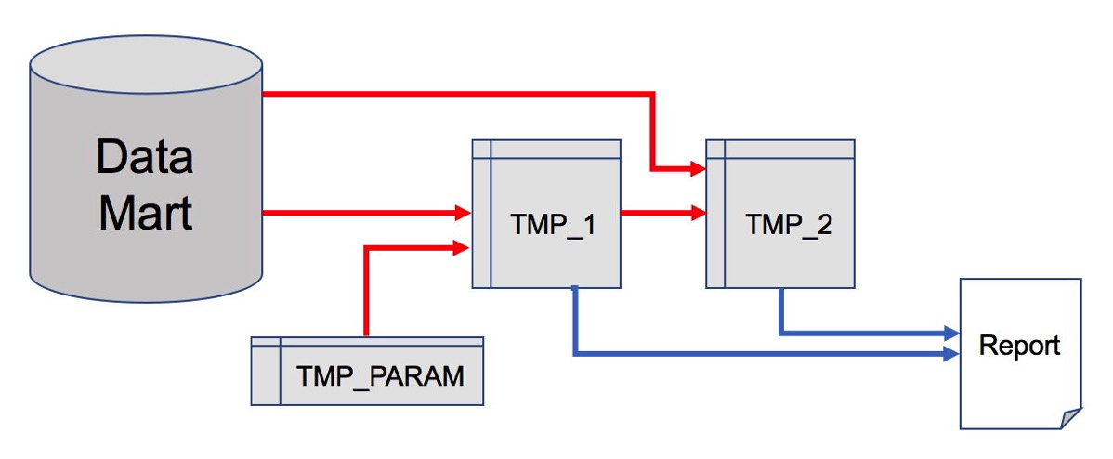
Lecture
SLIDE 7 / 14
Assignment Operator
SYNTAX
TempName ← QueryExpression assigns the result to TempName.
• The assignment operator (←) allows naming intermediate query results.
• It improves readability by breaking complex queries into logical steps.
• This is not part of the formal algebra but a practical extension.
• It prevents repeating complex sub-queries multiple × in a single statement.
• Essential for managing large, multi-step analytical queries efficiently.
Source: danischnider.wordpress.com
Chandigarh University
7 / 14
Notes:
The assignment operator is a practical tool for writing cleaner queries. Instead of nesting five layers of joins, we can name intermediate results. For example, we can first find all active users, then join them with orders. This makes the logic easier to follow and debug.

Slide 8
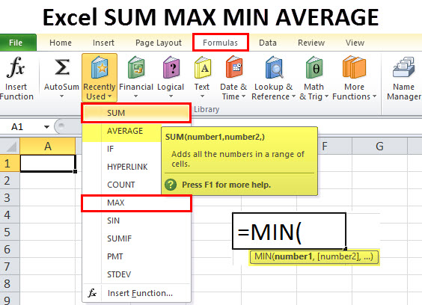
Lecture
SLIDE 8 / 14
Aggregation Functions
SYNTAX
F(Attribute) where F is the function and Attribute is the column.
EXAMPLE
SUM(Salary) calculates the total payroll for a department.
• Aggregation functions perform calculations on a set of values to return a single value.
• Common functions include SUM, AVG, COUNT, MAX, and MIN.
• They are typically used with the GROUP BY clause in SQL.
• These functions transform row-level data into summary statistics.
Source: cdn.educba.com
Chandigarh University
8 / 14
Notes:
Aggregation functions are vital for reporting. They take a set of values and return a single summary number. For instance, COUNT(*) gives the total number of records. SUM(Salary) gives the total payroll. These are fundamental for generating reports and dashboards in any database application.

Slide 9
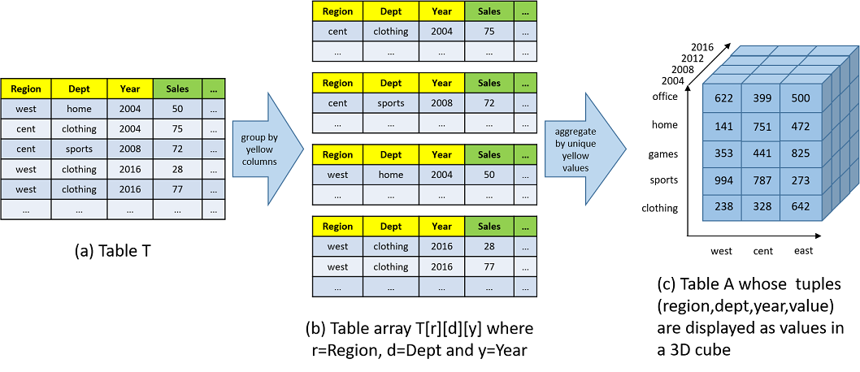
Worked Example
SLIDE 9 / 14
Aggregation
QUERY
Find the average salary for each department.
OPERATION
GROUP BY DeptID, then apply AVG(Salary).
STEP 1
Group rows by Department ID.
STEP 2
Calculate the average of the Salary column for each group.
RESULT
A table with DeptID and corresponding Average Salary.
• Relation Employee(EmpID, DeptID, Salary) stores employee salary data.
Source: www.cs.utexas.edu
Chandigarh University
9 / 14
Notes:
Let's calculate the average salary per department. We group the employee records by their department ID. Then, for each group, we sum the salaries and divide by the count of employees. This gives us the average salary for each department, which is crucial for HR analysis.

Slide 10
Lecture
SLIDE 10 / 14
Outer Joins
1
Outer joins return matching tuples plus non-matching tuples from one or both sides.
2
Left Outer Join keeps all tuples from the left relation.
3
Right Outer Join keeps all tuples from the right relation.
4
Full Outer Join keeps all tuples from both relations.
5
Non-matching tuples are padded with NULL values for missing attributes.
6
Crucial for identifying missing data or orphaned records in databases.
Chandigarh University
10 / 14
Notes:
Standard joins only return matching rows. Outer joins are different; they preserve unmatched rows. A Left Outer Join keeps all rows from the left table, filling missing matches with NULLs. This is essential for finding customers who have never placed an order, for example.

Slide 11
Lecture
SLIDE 11 / 14
Generalized Projection
SYNTAX
π F1, F2, ... (R) where Fi are expressions.
EXAMPLE
π Name, Salary × 1.1 (Employee) calculates a 10% raise.
• Generalized projection allows arithmetic expressions in the output list.
• It supports renaming attributes using the AS keyword or syntax.
• Enables dynamic calculation of derived attributes during query execution.
• Extends the basic projection operator to handle computations.
Chandigarh University
11 / 14
Notes:
Basic projection just lists columns. Generalized projection lets us compute new columns. For example, we can calculate a 10% raise by multiplying the salary by 1.1. We can also rename the resulting column to 'NewSalary'. This makes the query more powerful and self-contained.

Slide 12
Lecture
SLIDE 12 / 14
Common Pitfalls in Division
1
Division requires the divisor relation to contain only attributes from the dividend.
2
Empty divisor relation results in an empty set or all tuples depending on definition.
3
Null values in the divisor can lead to unexpected or incorrect results.
4
Ensure the dividend contains all necessary attributes for the division logic.
5
Performance can degrade significantly on large datasets without proper indexing.
6
Always verify the schema compatibility before applying the division operator.
Chandigarh University
12 / 14
Notes:
There are common pitfalls with division. If the divisor is empty, the result might be all tuples or empty, depending on the specific definition used. Null values can also cause issues. Always check that the attributes match correctly. Also, be aware that division can be slow on large tables.

Slide 13
Lecture
SLIDE 13 / 14
Key Takeaways
1
Extended algebra adds division, assignment, aggregation, and outer joins to basic operators.
2
Division is the primary tool for handling 'for all' type queries effectively.
3
Assignment operators improve readability by naming intermediate query results.
4
Aggregation functions summarize data using SUM, AVG, COUNT, MAX, and MIN.
5
Outer joins preserve unmatched tuples, essential for finding missing data.
6
Generalized projection enables arithmetic calculations and attribute renaming in queries.
Chandigarh University
13 / 14
Notes:
To summarize, extended relational algebra significantly enhances our query capabilities. Division handles 'for all' conditions, while aggregation summarizes data. Assignment makes complex queries readable. Outer joins help us find missing data. Generalized projection allows us to compute new values. Mastering these is essential for advanced database work.

Slide 14
Lecture
SLIDE 14 / 14
References
1
Fundamentals of Database Systems — Ramez Elmasri & Shamkant B. Navathe
2
Database System Concepts — Silberschatz, Korth & Sudarshan
3
Database Management Systems — Raghu Ramakrishnan & Johannes Gehrke
4
Oracle/MySQL Documentation — Oracle
Chandigarh University
14 / 14
Notes:
For further reading, please refer to the standard textbooks listed here. Elmasri and Navathe provide a comprehensive foundation. Silberschatz offers deep theoretical insights. Ramakrishnan is excellent for practical implementation details. Oracle documentation is essential for specific syntax in Oracle and MySQL environments.

